Slide 1

Course Title: Database System Concepts
Course Code : CSE311
Name : Thanjida Akhter
ID : 102-15-1030

Slide 2
Abstraction
The way we hide the data from the database user is abstraction
The Three levels of abstraction :
Physical level
Logical level
View level

Slide 3
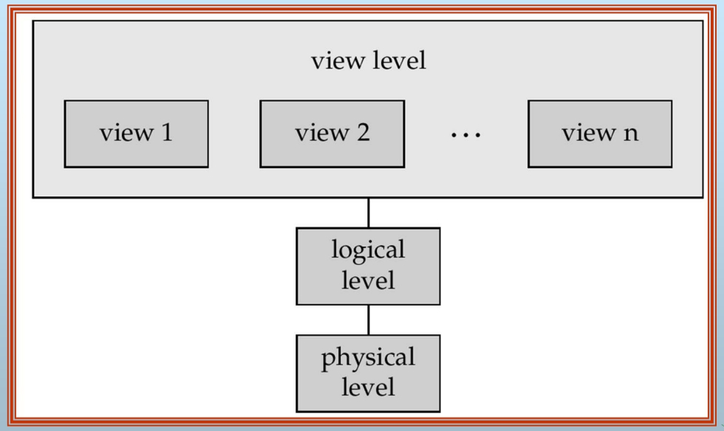
View of Data
Figure: The Three levels of abstraction

Slide 4
END

